Slide 1
The Bighorn Sheep, Peccary and Badger.
Group 5: Florianny, Lin, Zeida, Maria

Slide 2
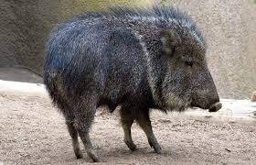
The Peccary
A peccary is a distant “cousin” of the domestic pig.The peccary has a similar barrel shaped body with dainter legs and feet. They travel in hurds and can be found in southern Texas and Arizona. They eat pear cactus, and to avoid the spines they pin down cactus pads with their hooves and peel the skin with their teeth.
The difference between a peccary and a pig is that the peccary’s tail is not visible and their ears are smaller
They have 38 teeth when mature, pigs have 44
Z

Slide 3
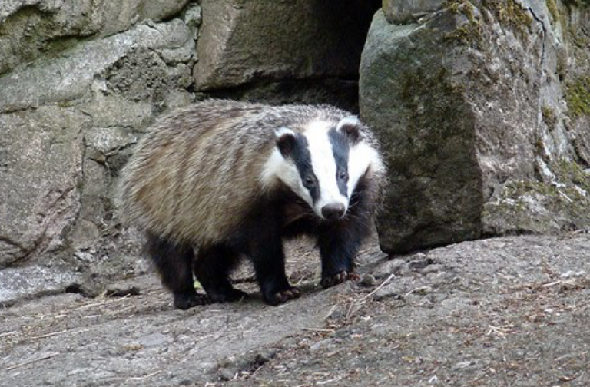
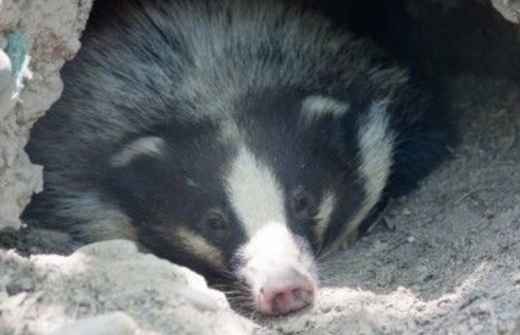
The Badger
Badgers are part of the weasel family, they are found throughout the world and live in different conditions and have developed different characteristics. However, honey badgers are not truly apart of this family because they are a subspecies.
Badgers generally weigh between 10 to 30 pounds and are omnivores, they eat smaller mammals, insects, and roots
They live in burrows, however not all badger types are social
Left: Eurasian badger
Right: Hog nosed badger
L

Slide 4
Bighorn Sheep
This particular animal has one of the most elaborate horns in any North American species. Though it also has other particular characteristics
Habitat:
Grassy slopes
Alpine meadows
Shrubby desserts
Diet:
Grasses, shrubs and small plants
Mineral licks
Behaviors
They use their horns for mating and defence
They leave their mothers at age 2 to join a leading ram. The ram leader is determined by horn and body size.
F

Slide 5
Hypothesis
We believe all three animals may be related.
We mainly believe the peccary and the bighorn sheep are the closest because they share a similar hair pattern in terms of coloring. The badger on the other hand has a striking black and white face (possibly to intimidate others as it doesn’t share the same head strength as the other two).
The peccary and the bighorn sheep are also similar in how they fight. While bighorn sheep are the only animals with horns, both share the same fighting tactics and clash head on with their thick skulls.
M

Slide 6
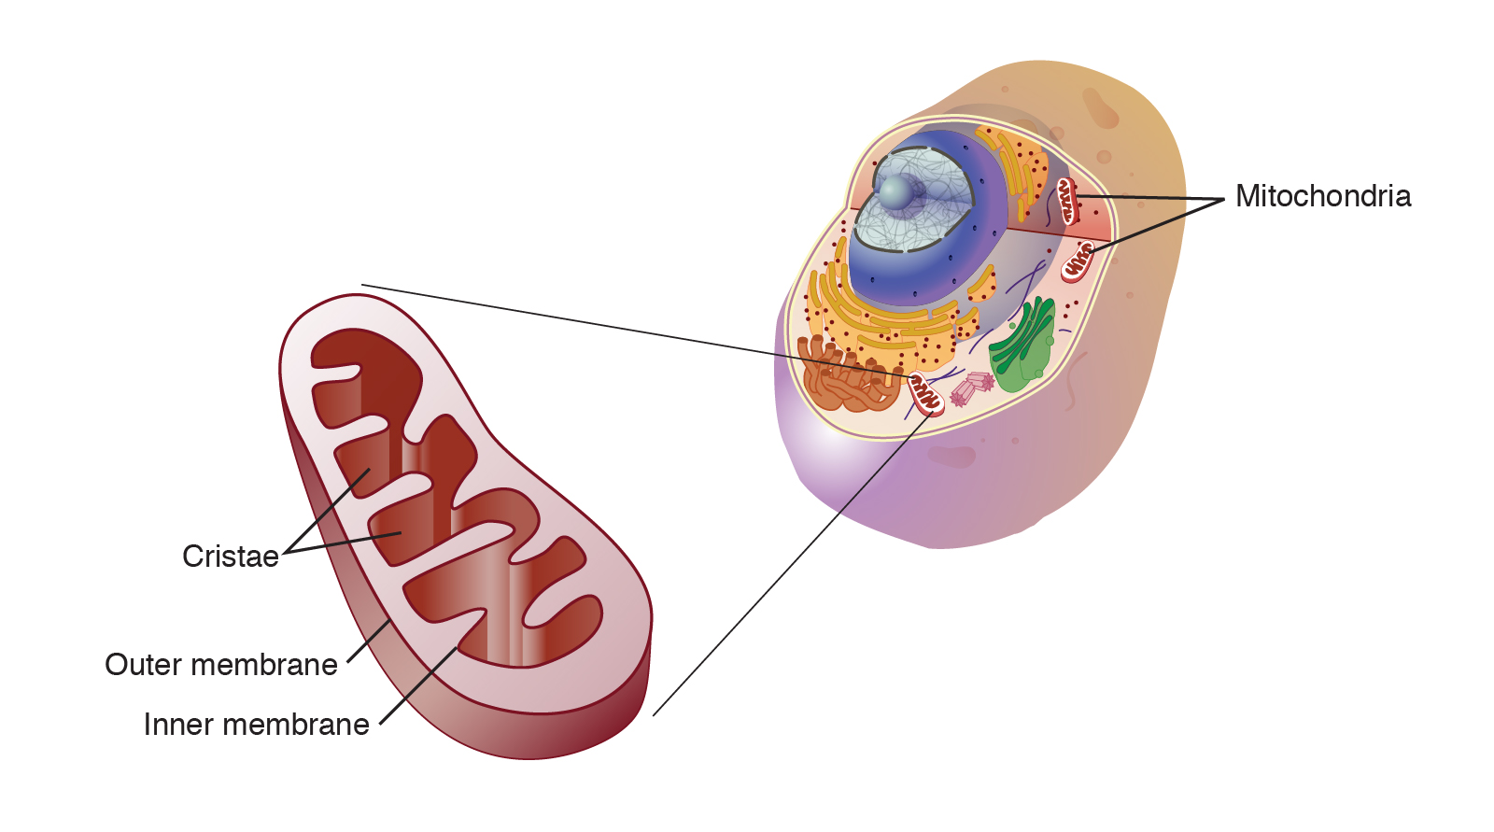
The Mitochondrial Gene
The Mitochondrial gene has:
37 genes
13 protein coding genes
The 13 proteins instruct the cells to make enzyme complexes of the oxidative phosphorylation system.
F
Notes:
Oxidative phosphorylation is the process in which ATP is formed as a result of the transfer of electrons. So basically the gene helps the cell make energy.

Slide 7
Project Goals
To find which animals share similar DNA
Learn how to use code in order to test a scientific hypothesis
Why use code?
Makes it easier to compare DNA sequences instead of having to type every gene
M

Slide 8
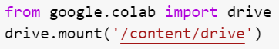
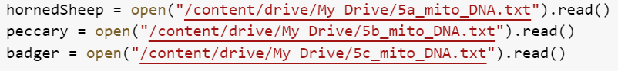
Code
First we mounted our drives.
Using the open and read functions, we opened our code (accessed by copying the path), and read the information in each text file.
F

Slide 9
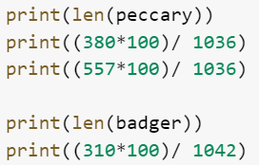
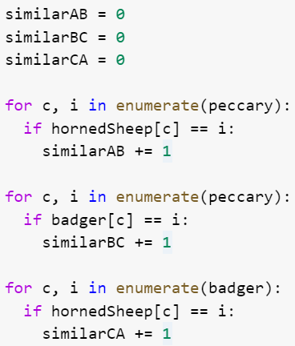
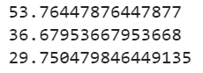
Code
We defined our counters.
For each item in the enumerated list with an index of “c”, if the item in the other list was the same, it would add 1 to our similarity counter.
To find the percent similarity, the formula is multiply the # of similarities by 100, then divide by the total # of items in the list that was enumerated.
Z

Slide 10
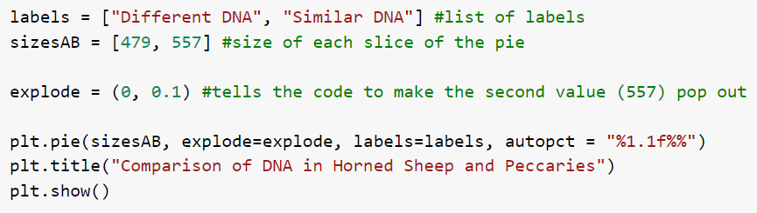
Code
plt.pie- specifications for pie chart, it allows the data, labels, slices, and percentages to be shown
plt.title- creates the title
plt.show- makes sure the chart is shown without any extra text
L

Slide 11
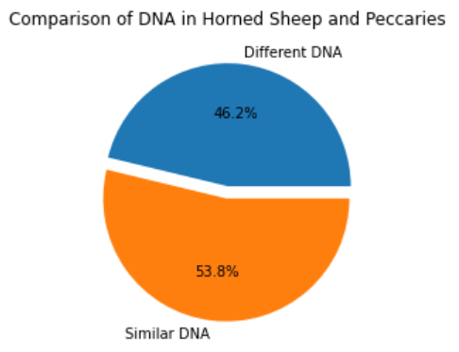
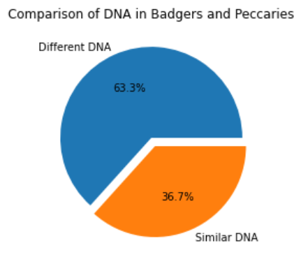
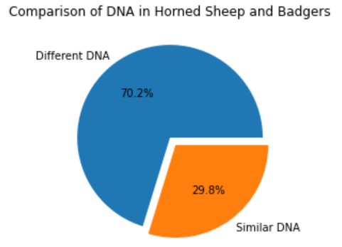
Visualizations

Slide 12
Conclusions
As a whole the animals had more differences than similarity.
Hypothesis was correct
Horned sheep and badger were the least similar.
Why compare homologies?
Understand evolution and origins
Find ways to understand diseases and functions
F
Notes:
Evolution Phylogenetic tree. Badger eat meat while horned sheep and peccary are herbibors. Mainly for that we have model organism

Slide 13
Challenges Solutions
The first issue we had was that, we were unsure on how to use Blast. We didn’t know what we needed to put in
We didn’t know what kind of graph we should do, we first decided on on doing a bar graph but then changed it to a pie chart.
Another issue we had was, we ended up enumerating the longer list instead of the shorter list.
Lastly, when creating the pie graphs, we set the sizes to [total # of genes, similarities]. This resulted in different percents than we had calculated.
We asked for help from Carol so that way we could understand how to us it.
She also mentioned to us how a pie chart would be better than using a bar graph to show our data.
We went through the code and realized that we needed to use a shorter list.
To fix this, we subtracted the total # of genes with the # of similarities so that both numbers would add up to the total.
Z
M

Slide 14
Next steps
Assign each animal a different color to make our graphs clearer and easier to read.
Compare similarities between RNA as well as DNA.
Using matplotlib, we could create additional graphs such as histograms and bar charts.
Compare homology to humans
L

Slide 15
Citations
http://www.badger.org/species.html
https://blast.ncbi.nlm.nih.gov/Blast.cgi?PAGE=MegaBlast&PROGRAM=blastn&BLAST_PROGRAMS=megaBlast&PAGE_TYPE=BlastSearch&DBSEARCH=true&QUERY=&SUBJECTS=

Slide 16
The End!!!
Any Questions?
:)

